Slide 1

Beer in the Year 2019
An in-depth analysis of craft brews and breweries in the United States
Notes:
Good Afternoon and thank you for the opportunity to present to you our findings on consumer interests with regards to beer in the year 2019.
My name is Paul Adams and with my business partner Armando Vela, we performed a high-level analysis of craft breweries and beers within the United States. Through the progression of this presentation, I will disclose our findings.

Slide 2
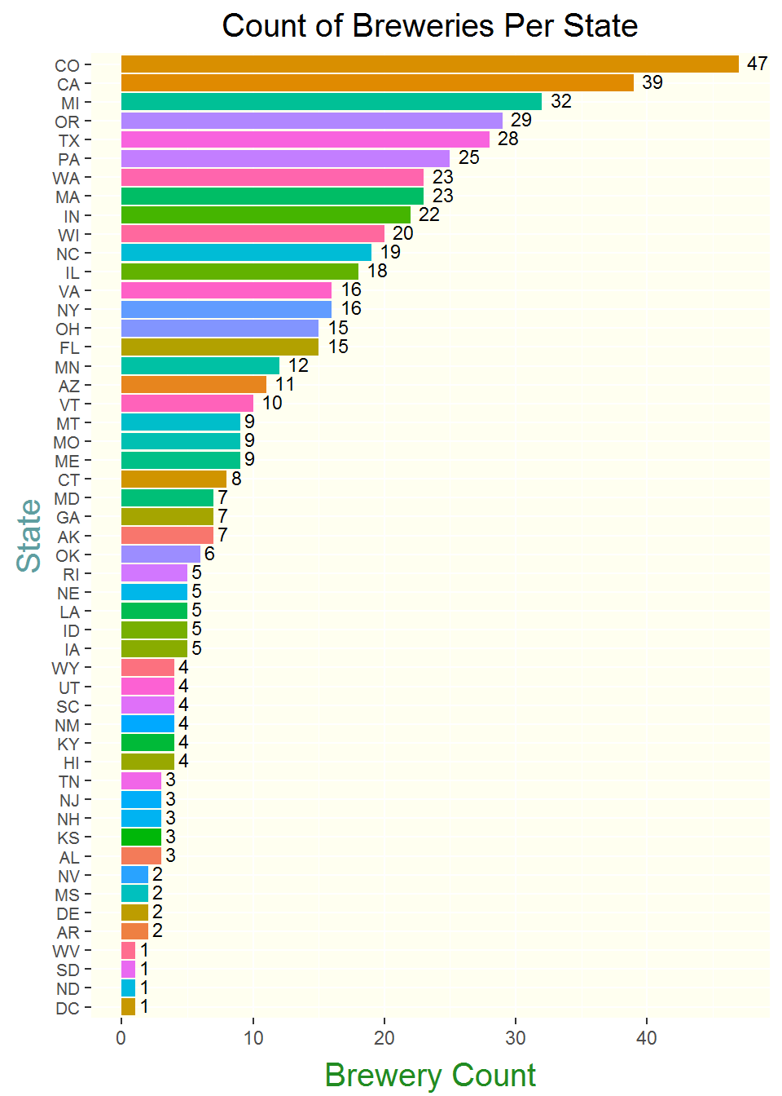
Insights by brewery Count
Notable regions of interest, by brewery count
West Coast
California, Oregon, Washington
Midwest
Illinois, Indiana, Michigan, Minnesota, Wisconsin
Colorado
Notes:
To begin our analysis, we gathered a total count of all breweries provided, by state.
Regionally, the West Coast and Midwest regions have the highest amounts of breweries. By state, Colorado leads the nation – with 47, followed by California at 39, Michigan at 32, and Oregon at 29.

Slide 3
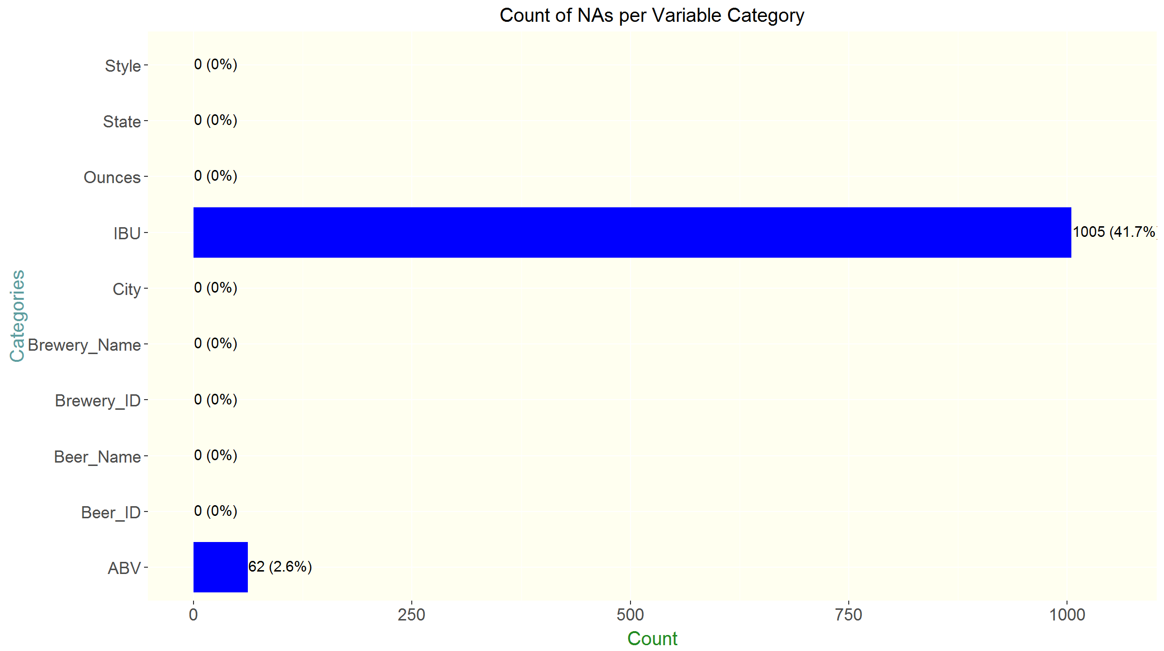
Handling missing data
Many responses to the surveys were either missing or incomplete
Missing values were completed using the medians for those values, by state
South Dakota received no IBU (bitterness) responses - national median applied in lieu
Notes:
With respect to data, we had some missing values. Bitterness – measured in IBUs - contained the most with over one thousand, which accounted for roughly 42% of all beers and breweries for which data was gathered.
To a lesser extent Alcohol by volume – measured in ABVs – was missing 62 data points, accounting for roughly two and a half percent of all beers and breweries.
Missing data provided some roadblocks in our analysis. To resolve these data discrepancies and maintain distinct metrics for each state, we applied interpolation. We did this by gathering the median values, by state, and applied those to the missing values within the respective states. For example, if Texas had 25 observations and only 20 valid data points, the missing 5 were provided by taking the median of the other 20.
South Dakota was the only exception to this. Because the state had no IBU data points gathered, a national median of 35 was applied.
Medians were selected for analysis over averages because there are outliers in the data relating to consumers who prefer either very strong or bitter beer, or the opposite, which provided less accurate representation of the beer markets.

Slide 4
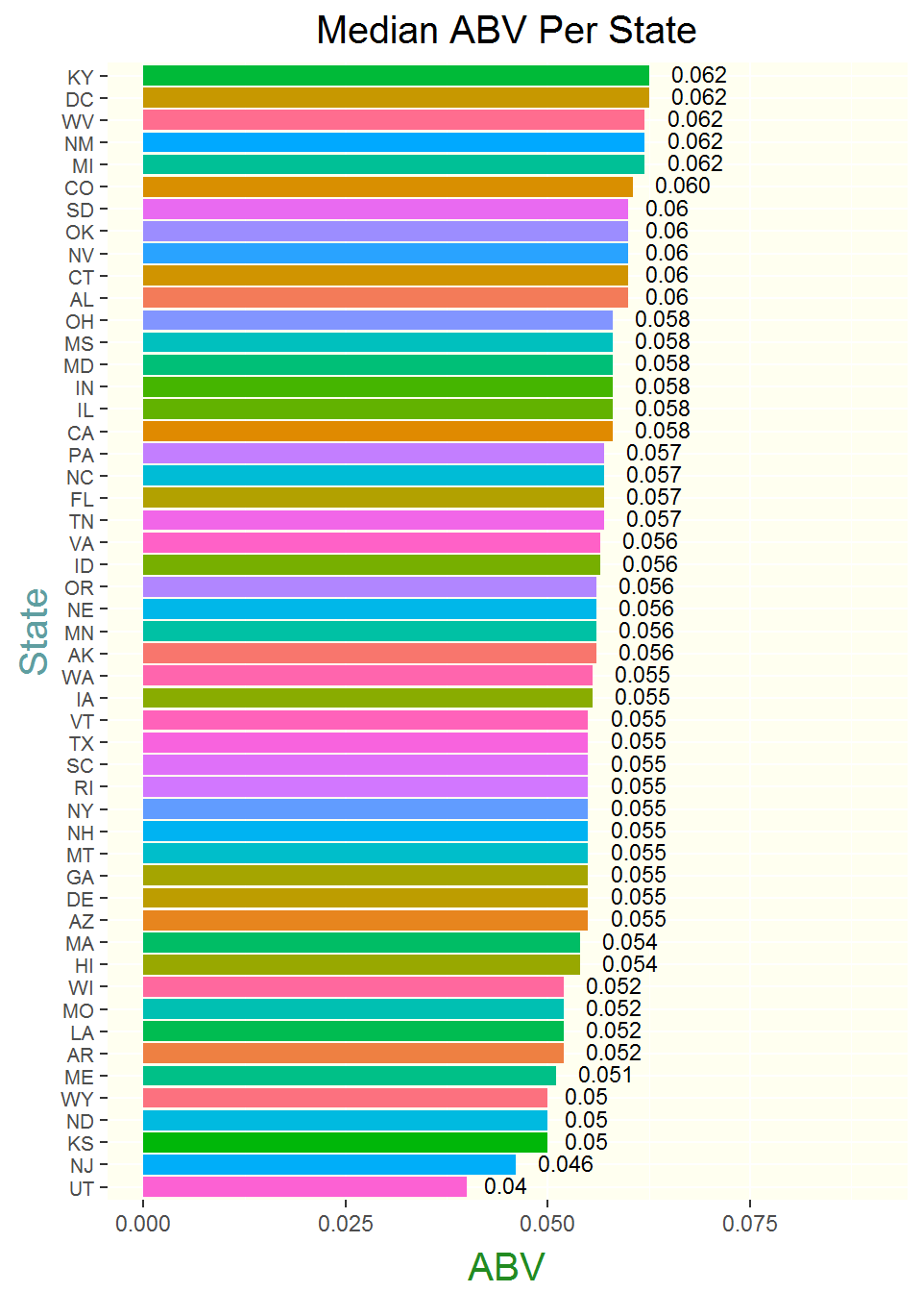
alcohol content insights
Roughly even distribution of ABV across all states
Highest ABV
Kentucky
West Virginia
Washington D.C.
Michigan
New Mexico
Lowest ABV
Utah
New Jersey
Notes:
Regarding alcohol content, with the exception of Utah – and to a lesser extent, New Jersey – most states have a similar median ABV. Kentucky has the highest ABV, tied with Washington D.C.

Slide 5
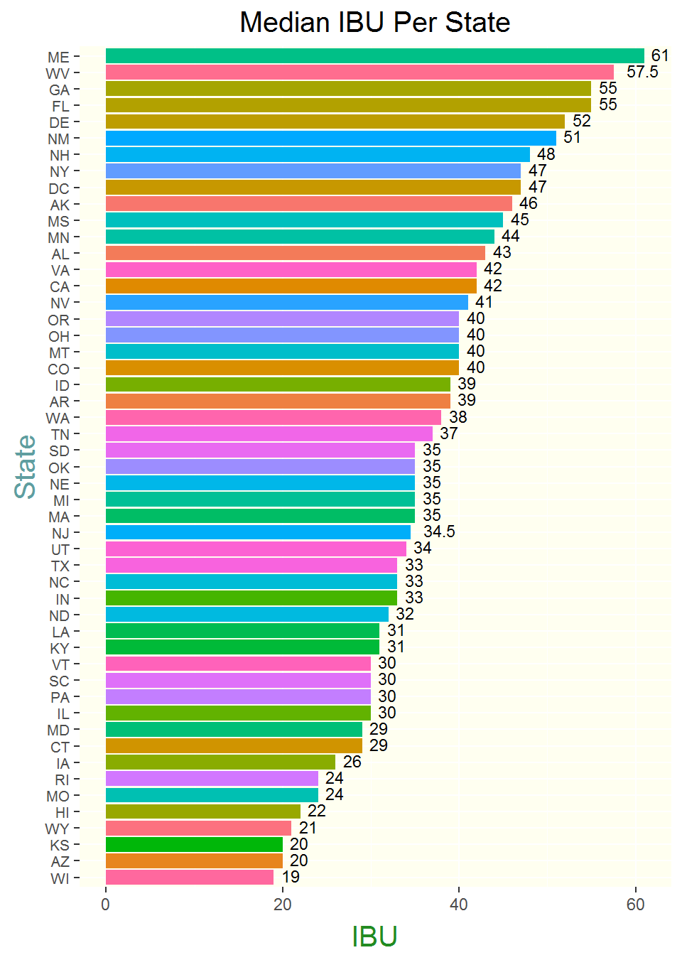
Insights on bitterness
Maine likes it BITTER!
Highest bitterness (following Maine)
West Virginia
Georgia
Florida
Delaware
Least bitter
Wisconsin
Arizona
Wyoming
Hawaii
Notes:
In terms of bitterness in IBUs, Maine has the highest levels. As with ABV, West Virginia and Washington D.C. are again in the top ten. The states with the least bitter beer are

Slide 6
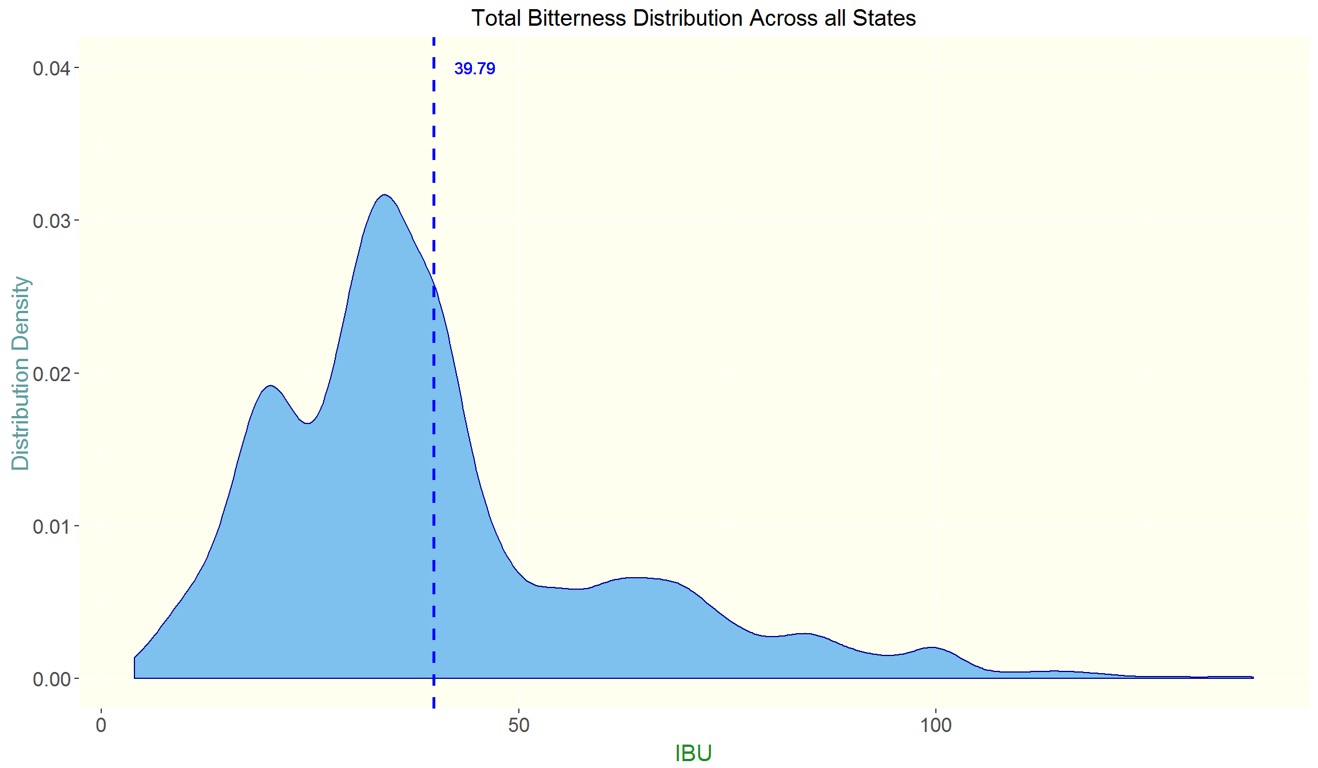
The general consensus: bitterness
Mild bitterness for mass production
Moderate-to-heavy bitterness for smaller or niche markets (further analysis and data required to determine which)
Notes:
Through analyzing the density distribution of beer – in terms of bitterness – there seems to be a moderate central tendency, but also a heavy tail skewed toward bitter beer. It appears there are subgroups for varying levels of bitterness. They could represent smaller states or possibly market nitches – we can confirm this through more data and in-depth analysis.

Slide 7
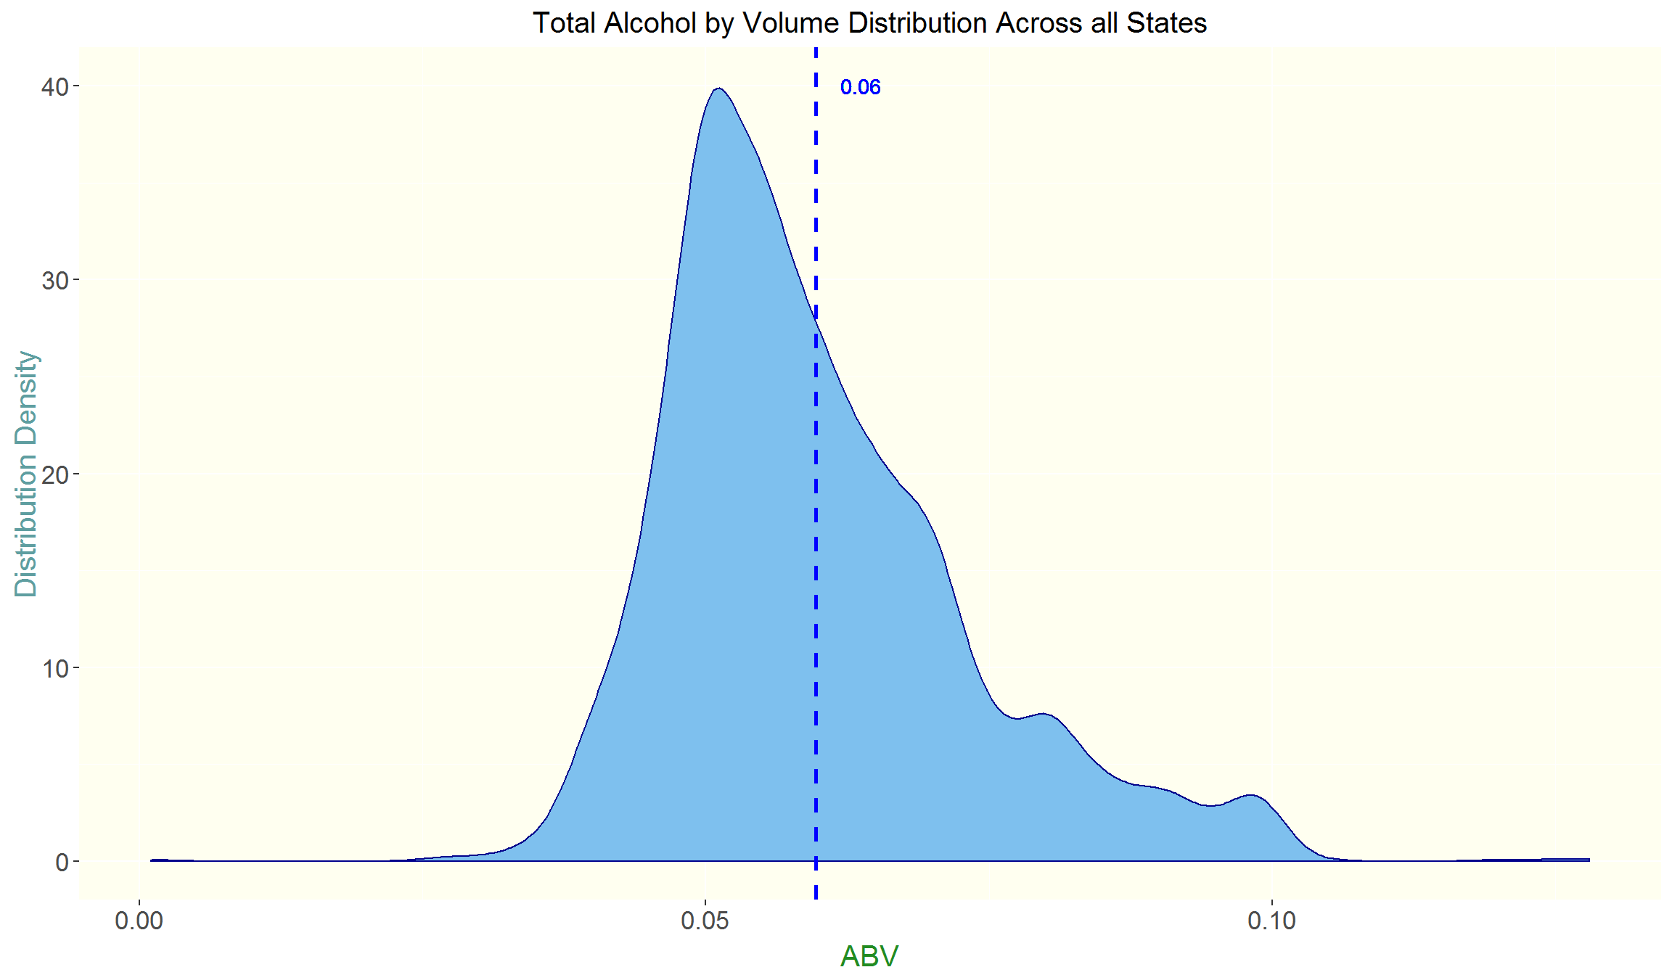
the general consensus: alcohol strength
Nationwide, the tendency is toward the middle
Smaller or niche markets prefer stronger beer (further analysis and data required to determine which)
Notes:
With regard to ABV, the majority of consumers prefer a moderate-strength beer of roughly 5 to 6.5%. However, there is a considerable volume of consumers who enjoy beer of up to roughly 12% ABV. Beyond this point, there are only major outliers.

Slide 8
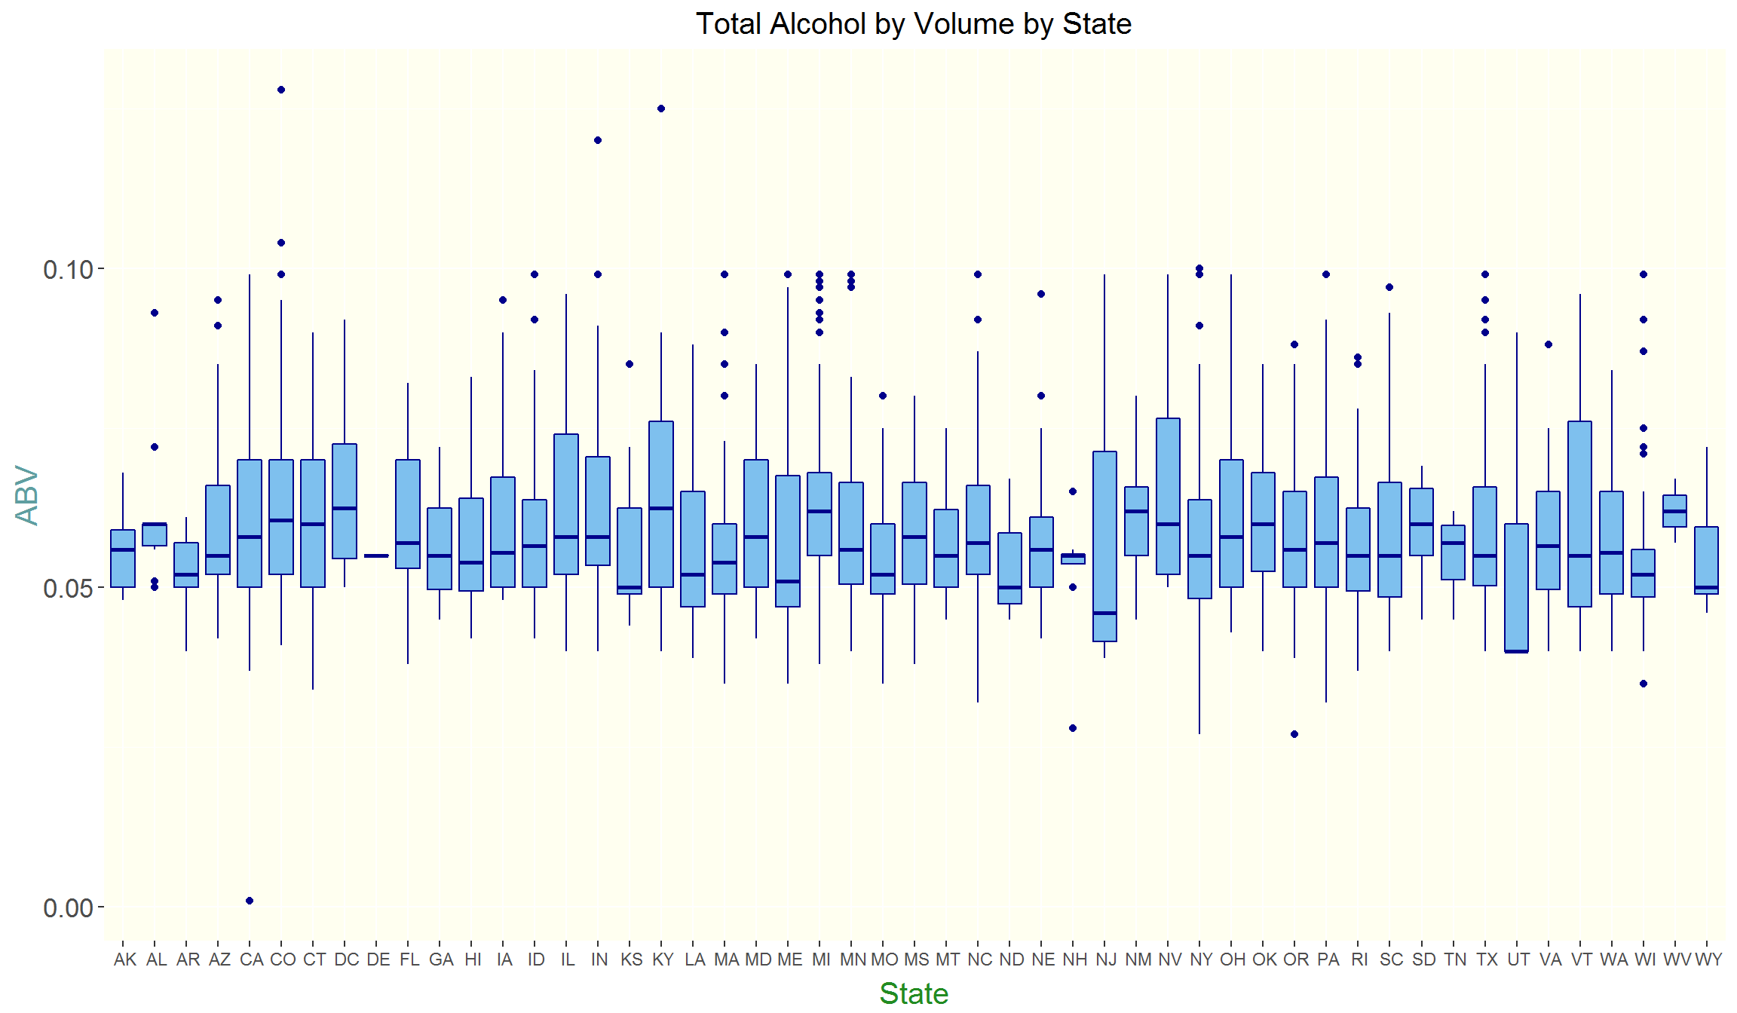
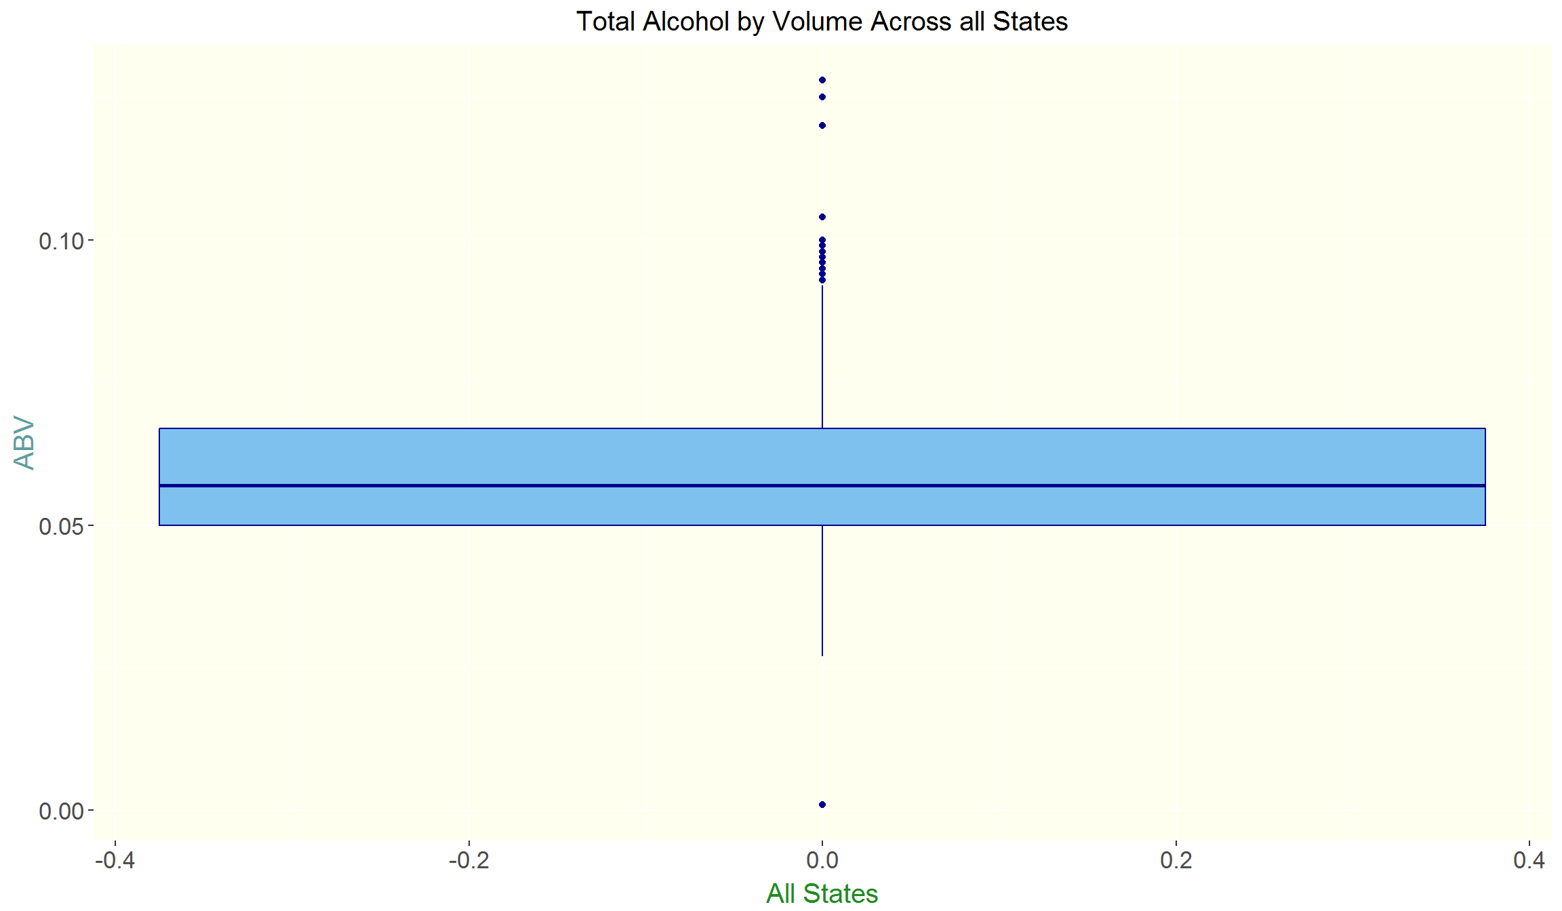
Attitudes toward alcohol strength
Americans agree on strength
Wide range of tastes for alcohol strength with shared middle 50th percentiles across most states
Notes:
Within the box and whisker plots for ABV, most states have a similar distribution of ABV. As with the distribution plot, most prefer a mild beer, but there are enough consumers who enjoy a higher volume of alcohol to see the middle 50th percentile prefer beer from roughly 5 to 7% ABV. The top 25 percent of most states hovers around 8 to 9%.

Slide 9
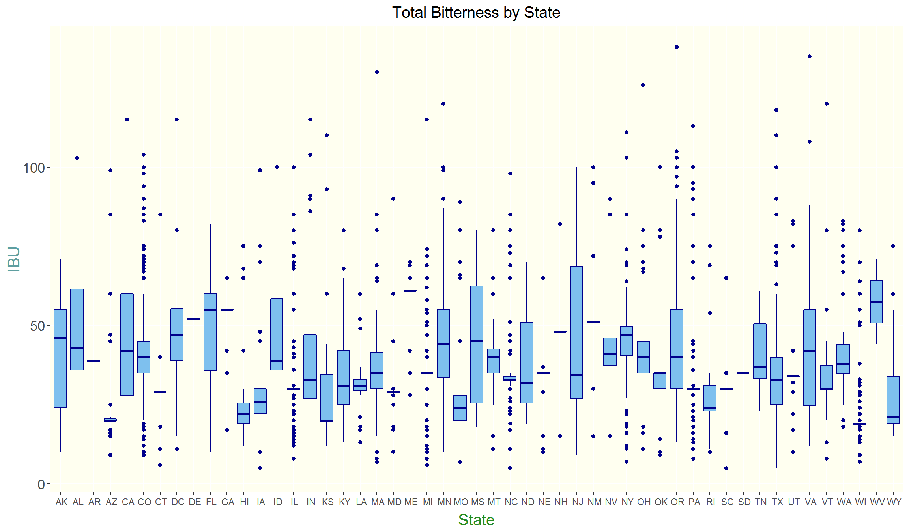
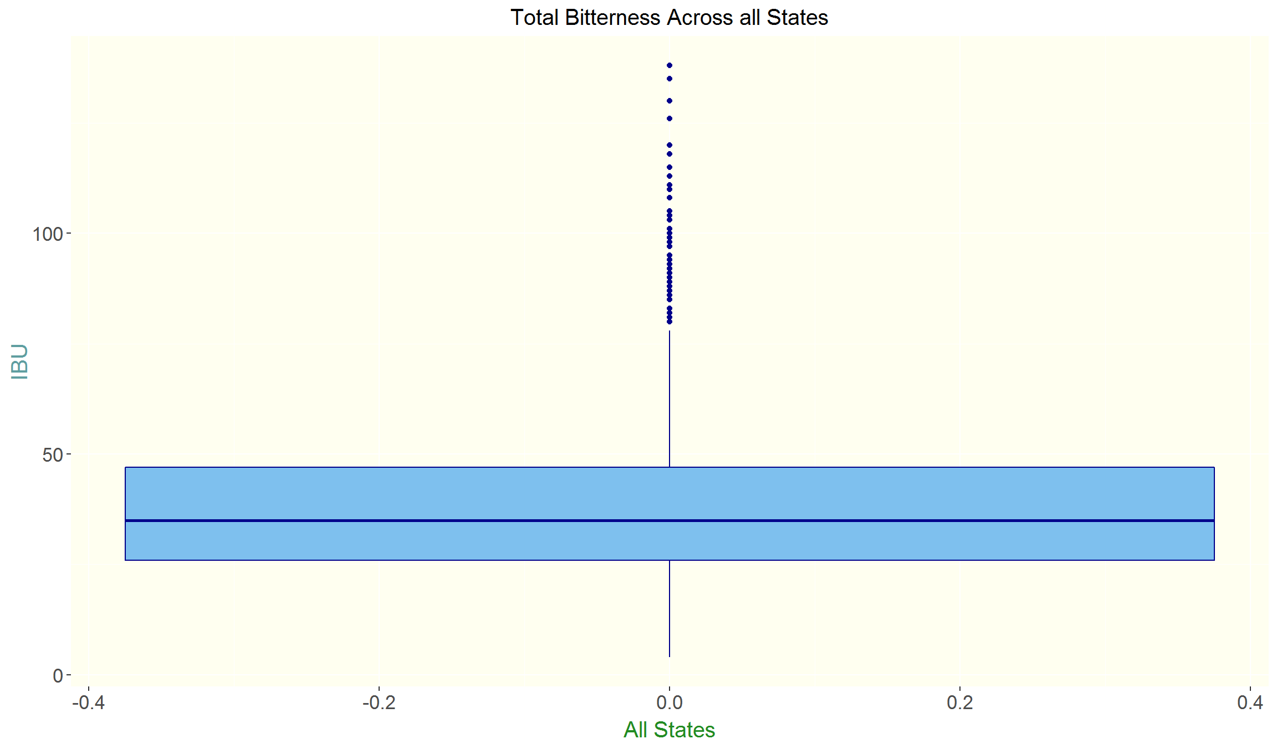
attitudes toward Bitterness
Americans do not agree on bitterness: some like it bitter, others like it smooth
Some states are open to all levels of bitterness, thus more niche markets
California, Mississippi, New Jersey
Notes:
With respect to bitterness, there is not a very strong consensus, but the middle 50th percentile of most states do remain somewhat within a relative range. There are outliers on both the more and less bitter side – indicated by the stray dots - but generally, most outliers skew toward a more bitter beer.
States such as Arkansas and Delaware have a very limited range of preferences, where consumers seem to prefer mostly one type of beer. The collection of more data through traditional methods such as in-person interviews would provide more insight into these states and their preferences.

Slide 10
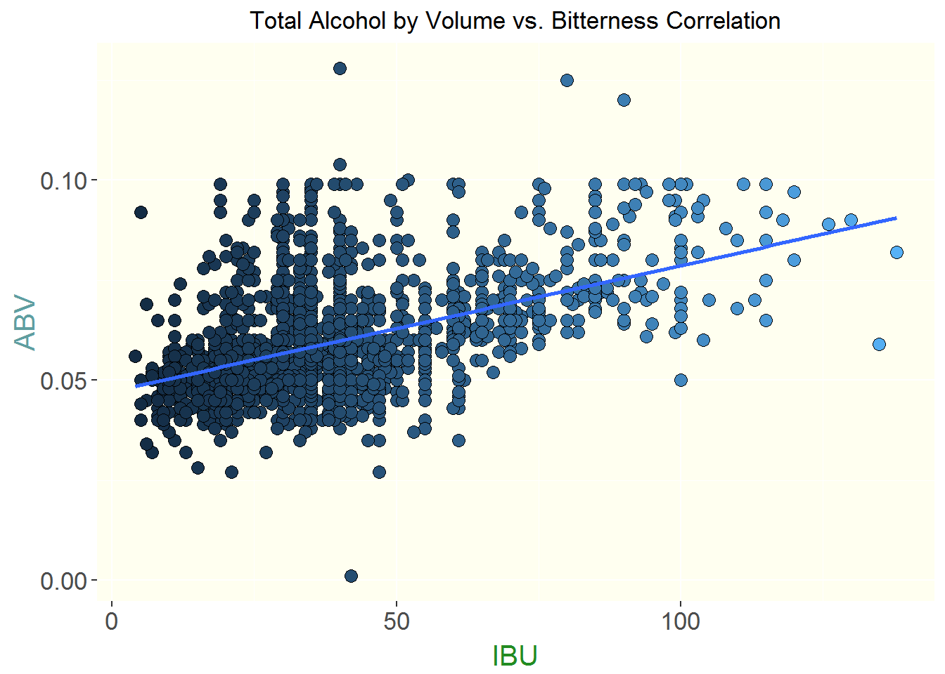
is bitterness and alcohol strength related?
Analysis of scattered data points indicate strong level of correlation
Bitterness compared to Alcohol by Volume
Notes:
From this scatter plot, it can be seen that there is strong evidence of correlation associated with bitterness and alcohol content; essentially, the more bitter the beer, the more alcoholic it is.

Slide 11
Beer takeaways
For small-scale production and distribution, bitter and strong (ABV)
For large-scale production and distribution, smooth and moderate (ABV)
Further analysis needed to understand the markets
market sizes and population density
advertising campaigns
alcohol “culture” studies using focus groups
consumer age analysis
Notes:
Some key takeaways are that for small-scale production and distribution networks, the bitter beer with higher alcohol contents can be a strong market.
Conversely, for large-scale production and distribution networks, a milder and smoother beer would provide a more stable market.
Further analysis would be needed to understand the underlying trends and populations of the individual markets and to target markets with precision.
Such analyses could include:
looking at market sizes and the density of their populations;
studying advertising campaigns and what beers have been marketed by region;
performing alcohol culture studies using focus groups to understand what it is consumers truly prefer and the influencers impacting their preferences and decision making;
another method we could use would be to study the age groups and what types of beer each age category purchases.
Thank you for your time today. If desired, P&A Consulting would be more than happy to engage in further analyses to provide more in-depth understanding of the markets and their underlying trends.

